Slide 1

HO CHI MINH CITY UNIVERSITY OF TECHNOLOGY
FACULTY OF COMPUTER SCIENCE AND ENGINEERING
Logic Design Project
LCD1602 and DHT-20 Sensor Expansion Shield for STM32 Nucleo Development Board
COUNCIL: COMPUTER ENGINEERING 2
INSTRUCTOR: Ph.D. LÊ TRỌNG NHÂN
01
02
03
Cao Minh Quang
2052221
Lê Tuấn Hưng
2052508
Trần Cao Duy Trường
2052299

Slide 2
Contents
01
Introduction
02
Devices and Components
03
System & Program Design
04
Demonstration Result
05
Conclusions & Perspectives
01

Slide 3

01
Introduction
A brief overview of the project target
Information about the expansion shield
02

Slide 4





Project Target
Hardware Design
Enhance skill in circuit design, soldering components and debugging.
MCU - MPU Course Practical Usage
Apply technical skill in C programming language and defining FSMs.
Device Drivers
Practice implementing device drivers for different devices.
Hardware Communication Protocol
Understand the working principle of UART & I2C and apply them in the project.
03

Slide 5
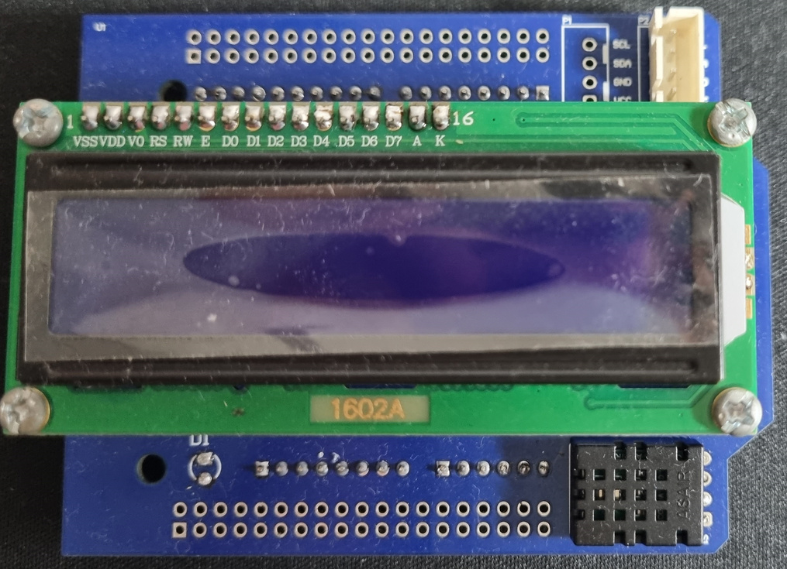
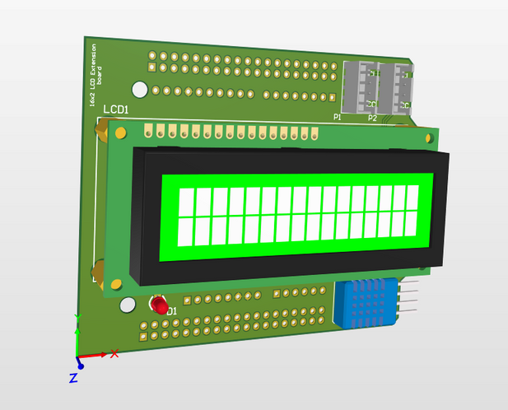
LCD 1602 and DHT-20
Expansion Shield
The DHT20 sensor is used to measure temperature and humidity.
The LCD displays measured value.
2 header extension for I2C devices.
04

Slide 6

02
Devices &
Components
I2C Communication Protocol
LCD1602 & PCF8574AT
DHT-20 Sensor
05

Slide 7
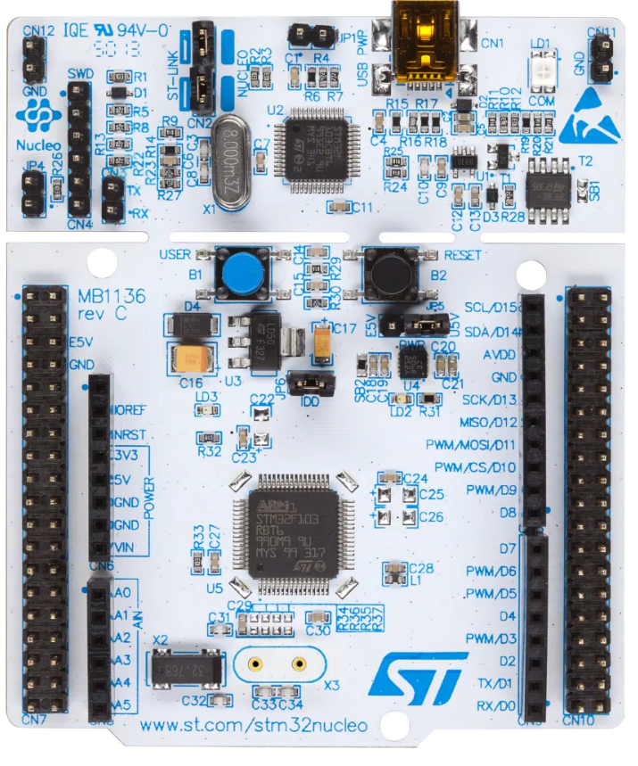
STM Nucleo Development Board with STM32F103RBT6 MCU
Core: ARM 32-Bit Cortex-M3 CPU
Memories: 64 or 128 Kbytes of flash memory and 20Kbytes of SRAM
Peripherals: DMA, Motor Control PWM, PDR, POR, PVD, PWM, Temp Sensor, WDT
Speed: 72MHz
06

Slide 8
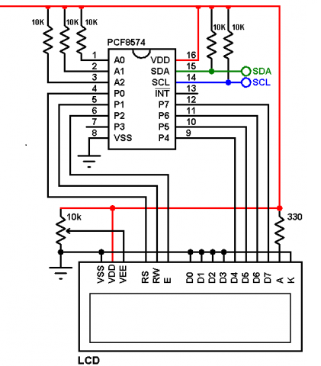
Why using LCD1602 with PCF8574
The PCF8574/74A helps to convert data signal to perform an I2C communication to the LCD.
Using I2C reduces the connection from 12 to only 4 pins.
Easier to maintain code flow.
07

Slide 9
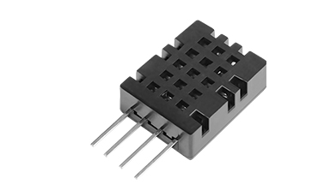
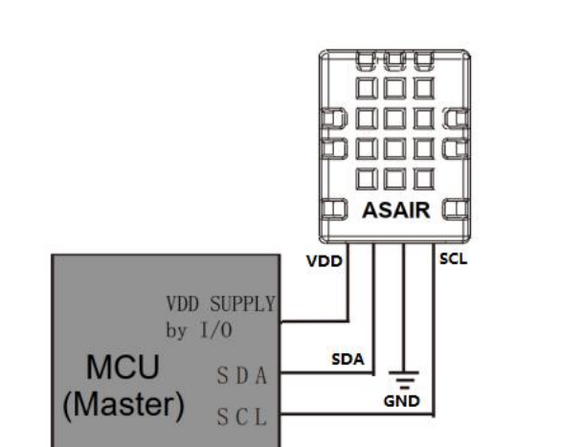
DHT-20 Sensor
High-performance semiconductor silicon-based.
Capacitive humidity and temperature sensor.
I2C Output Signal.
08

Slide 10
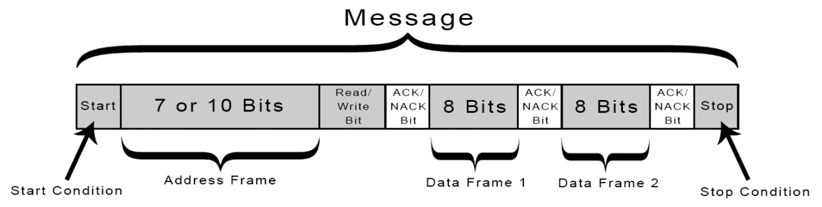
I2C Protocol Working Principle
The main function of STM32 HAL library for I2C:
HAL_I2C_IsDeviceReady( );
HAL_I2C_Master_Transmit( );
HAL_I2C_Master_Receive( );
09

Slide 11
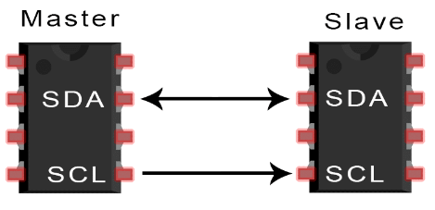
Advantage of I2C Communication
Reduce the number of PINs need for connection.
Multiple-master and multiple-slave flexibility.
ACK/NACK bit gives confirmation
that each frame is transferred
successfully.
10

Slide 12
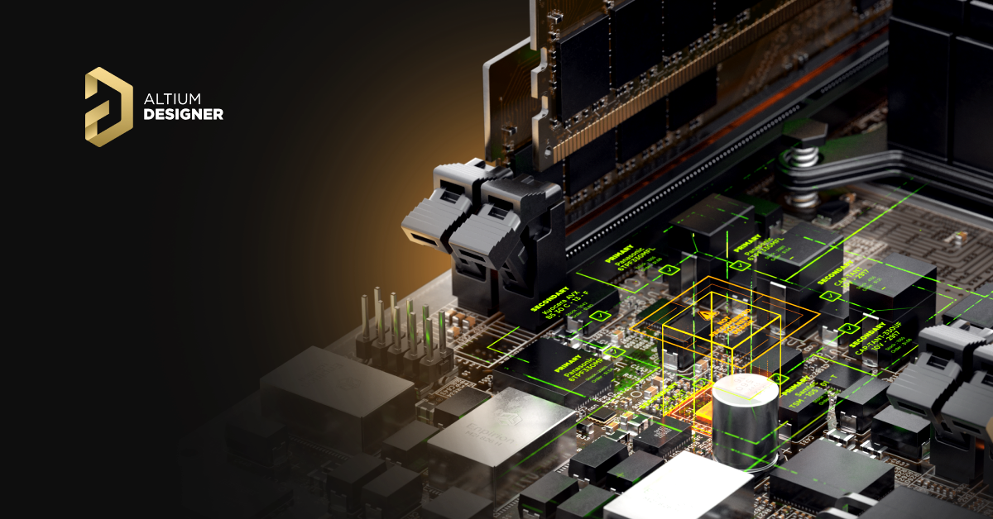
03
System &
Program Design
Hardware design with Altium Designer 21
Block diagram for the system
Proposal architecture for the system
Finite state machines
11

Slide 13
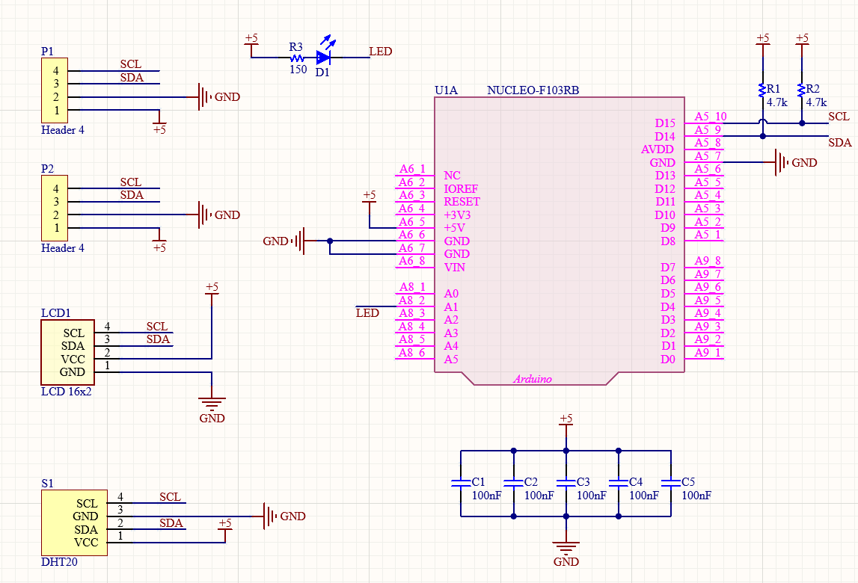
Schematic
Schematic library provide by Chipfc
Design on Altium Designer
Version 21.6.4
12

Slide 14
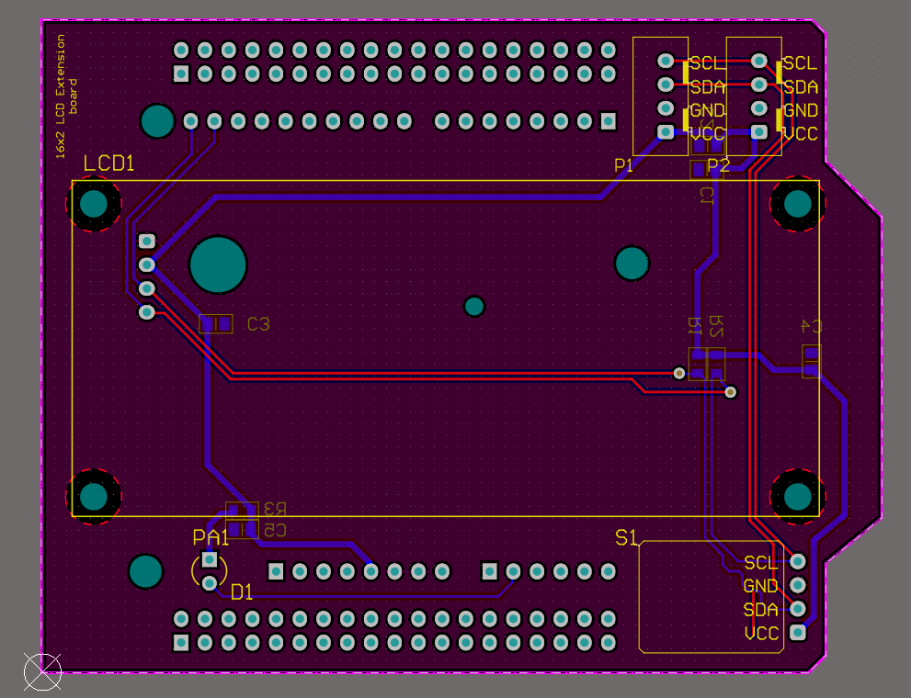
PCB Layout
Footprint library and
3D model provide by Chipfc
13

Slide 15

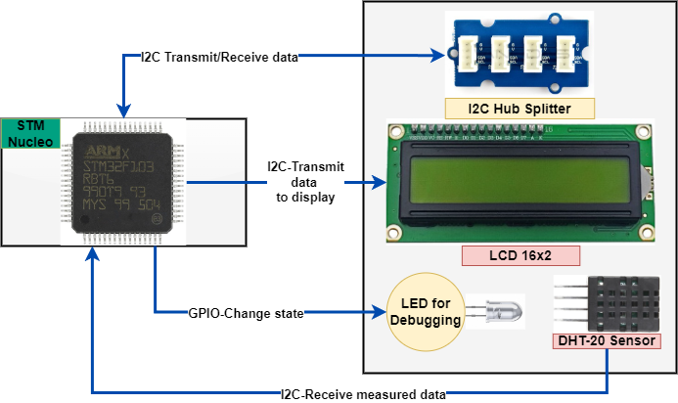

Block diagram for the system
14

Slide 16

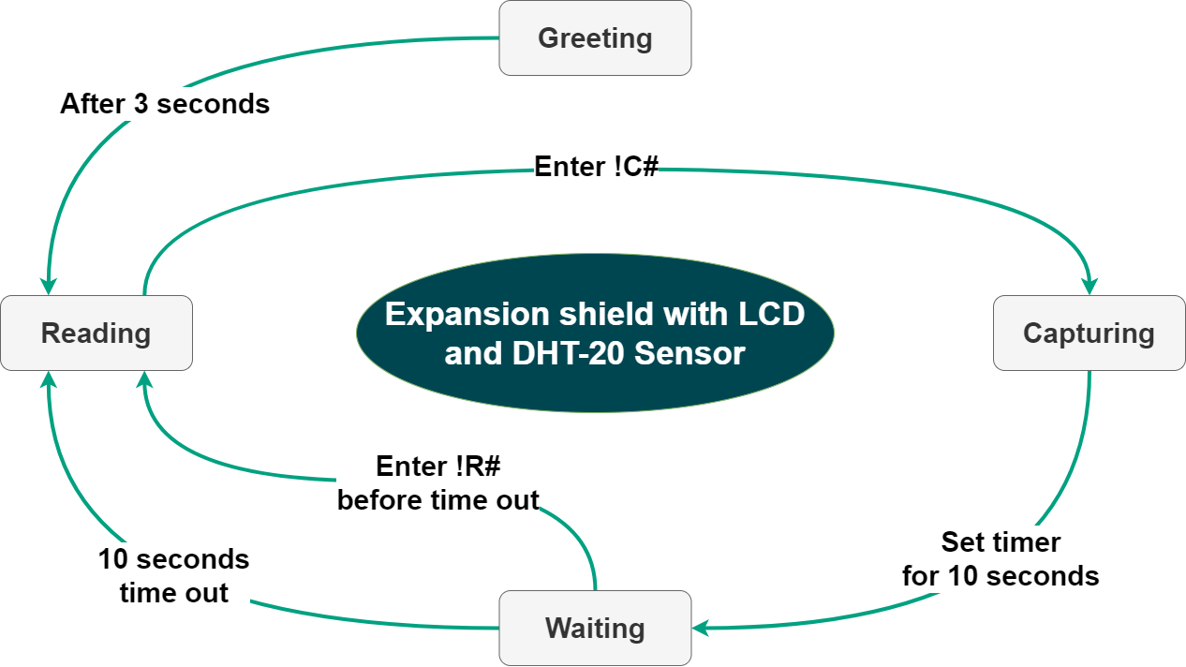
Proposal Architecture
A command has the form !'content'#.
15

Slide 17
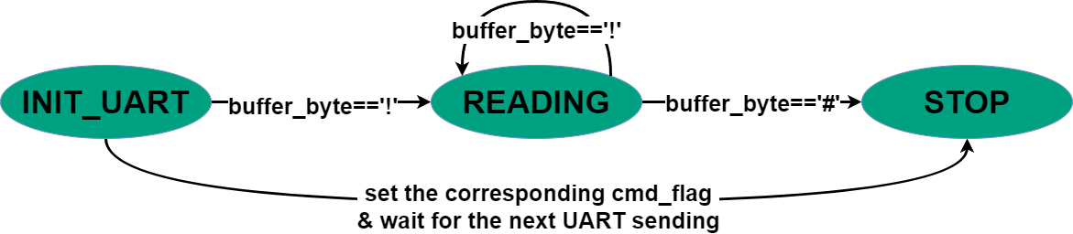
FSM for command parser
This FSM acts as a signal generator for the operation of the system.
16

Slide 18
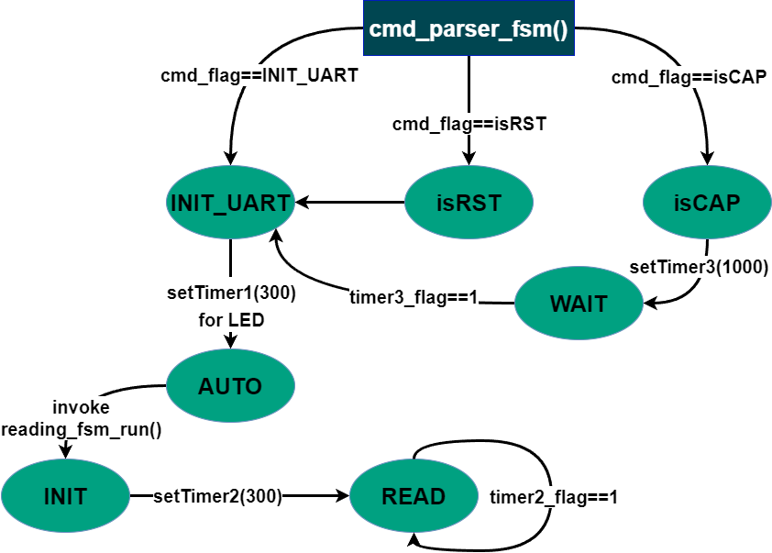
FSM for the whole system
This FSM will intercept the signal and perform the associated action.
The software timer is called every 10ms.
In each call, the counter will be decreased by 1.
So setTimer(100) is equivalent to 1 second timer.
17

Slide 19
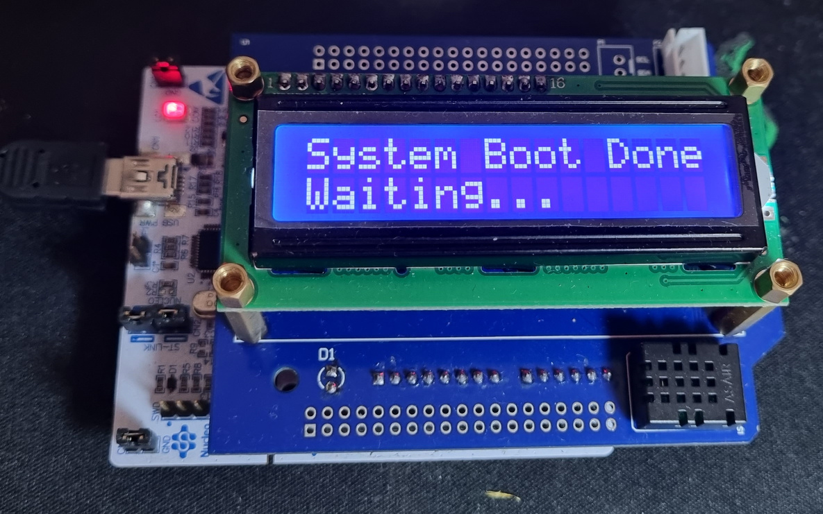
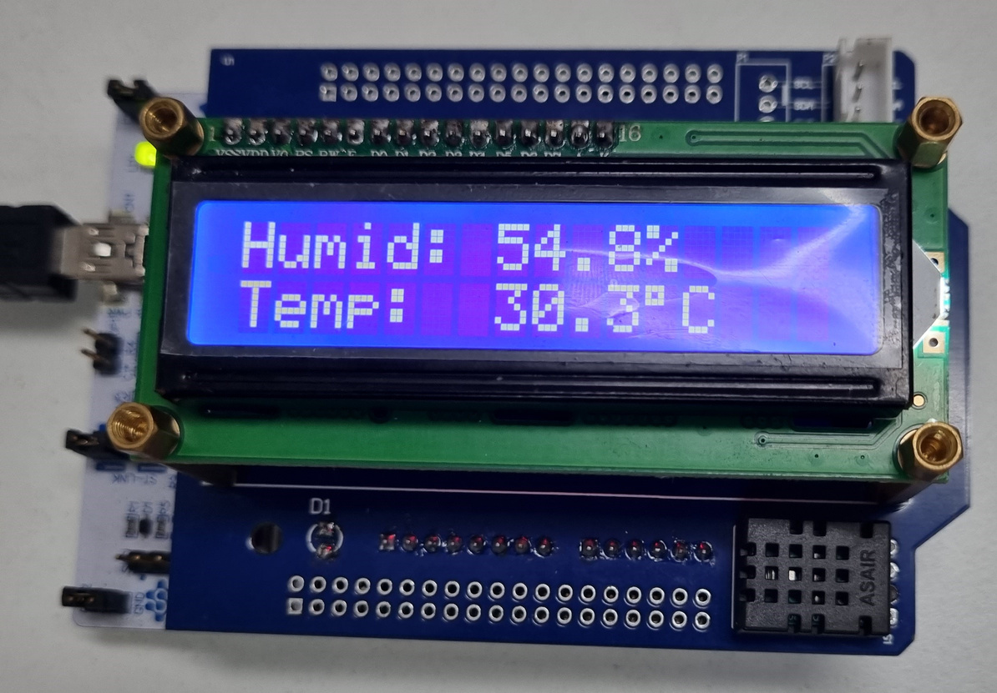
04
Demonstration
Result
Present the functionality of the shield
18

Slide 20

05
Conclusions &
Perspectives
19

Slide 21

I2C Communication Protocol
Research and implement the shield with I2C devices.
Conclusions
LCD 1602 & DHT-20 Sensor
Understand the properties and behavior of the devices.
Expansion shield
Propose an architecture and implement the fully operative system.
20

Slide 22

Perspectives
Expanding to IoTs direction with air purifier system.
Adding more sensors for PM 2.5 dust and harmful gases detection.
Mobile application to display, notify, supervisor, and control the system.
21

Slide 23

Thank you so much for your attention !
This is the end of our presentation.
Logic Design Project - Semester 221

